Slide 1
Public Opinion · Public Policy · Organizations · Campaigns
1987 – Founded in San Diego
1988 – Phonecenters established in Riverside, CA and San Diego
1990 – Phonecenters established in Reno, NV and San Diego
1992 – Predictive dialing installed to double interviewing capacity; CERC calls San Diego Mayor’s race
1993 – "The Edge" newsletter launches
1998 – Qualitative focus groups introduced
2000 – CERC calls San Diego Mayor’s race
2003 – KPBS/Competitive Edge Research Poll and annual Super Bowl poll launched
2004 – CERC calls San Diego Mayor’s race (x2)
2005 – CERC calls San Diego Mayor’s race (x2)
2006 – SDIPR/CERC Opinion Barometer launched; Ballot measures paper presented at AAPOR Conference
2008 – CERC calls San Diego Mayor’s race; Convenes post-election summit @ USD
2009 – Interviewer effects paper presented at AAPOR Conference
2010 – Web-based interviewing and custom panels introduced
2012 – Dial-testing introduced; CERC calls San Diego Mayor’s race (x2)
2013 – CERC calls San Diego Mayor’s race; Business Forecast survey launched
2014 – CERC calls San Diego Mayor’s race
2016 – CERC calls San Diego Mayor’s race
2017 – Phonecenter established in El Paso, TX
2018 – CERC calls CA Governor’s race (x2)
2019 – Ballot measure wording paper presented at AAPOR Conference
2020 – Incumbent viability paper accepted for presentation at AAPOR Conference
2022 – San Diego County Issues Barometer launched
John Nienstedt, MA Political Science: President
Member, American Association for Public Opinion Research
SBA Entrepreneurial Success Award (2000)
Pollster of the year (x7)
Rachel Lawler, MA Political Science: Research Analyst
Member, American Association for Public Opinion Research
Ronald Zavala: Director of Operations
James Iwu: Research Assistant

Slide 2
San Diego County Issues Barometer Dec. 2022
Finding Healthy Food is Easy, but Food Deserts are a Concern, and Food Insecurity is a Serious Regional Issue
More Blacks Desire Government Programs, But All Ethnic Communities would Generally Pitch in to Help

Slide 3
Summary
Research Objective: 1) Explore food insecurity issues
Sample Size: n=504
Margin of Sampling Error: ± 4.4%
Confidence Level: 95%
Sample Methodology: Simple random sampling from listed sample
Jurisdiction: San Diego County
Eligibility: Adult residents
Interview Methods: Telephone (including cell phones), e-mail push-to-web, text push-to-web
Field Dates: December 1-6, 2022
Field Facility: Competitive Edge Research, El Paso TX
Project Director: John Nienstedt, Sr.
Research Analyst: Rachel Lawler
Research Assistant: James Iwu

Slide 4
Background

Slide 5
33.8 Million Americans are Food Insecure
Defined as: “At times during the year, these households were uncertain of having or unable to acquire enough food to meet the needs of all their members because they had insufficient money or other resources for food”
Roughly 8 million Californians face food insecurity
Including > 330,000 in San Diego County
Levels remain elevated compared to pre-COVID times
Research increasingly links poor nutrition to poor health outcomes.

Slide 6
Household Access to Nutritious Food

Slide 7
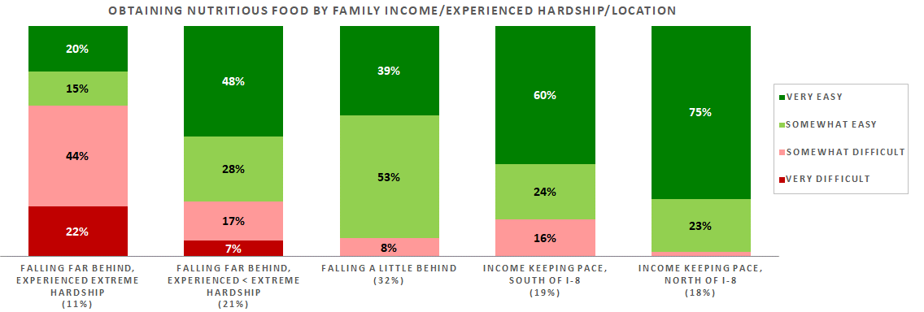
Easy Access is Not a Problem for Most
> half a million San Diegans -- 18% of the population – do struggle with this
130,000 or 4% are very food insecure
Those straining to make ends meet often have a harder time getting good food
This is the case regardless of where one lives
Personal food insecurity is essentially limited to this group
Food access is not a problem for financially stable folks
Almost never an issue north of I-8
Access to nutritious food is primarily a financial issue.

Slide 8
A Closer Look at Our Ethnic Communities
Access to nutritious food at convenient locations can be more difficult for Blacks
Access among Asians and Latinos is no different than for the overall population.

Slide 9
Food Deserts

Slide 10
Lack of Consensus on Food Deserts
57% say most in their community can access affordable, healthy, nutritious food
But only 22% think that’s a very accurate description
And 38% feel that characterization is inaccurate
But only 14% think it’s very inaccurate
Views are largely driven by personal experience
A huge 73% of those for whom it’s very difficult to get food believe their community lacks access
But if it’s very easy to get your own food, then you’re not in a food desert
Those with moderate hurdles are divided:
Non-Whites and
Whites 55+ tend to be in food deserts, at least somewhat
Young Whites are not.

Slide 11
A Closer Look at Our Ethnic Communities
Perceptions of community access to healthy and affordable food reflect those of the broader population.

Slide 12
How Serious is Food Insecurity?

Slide 13
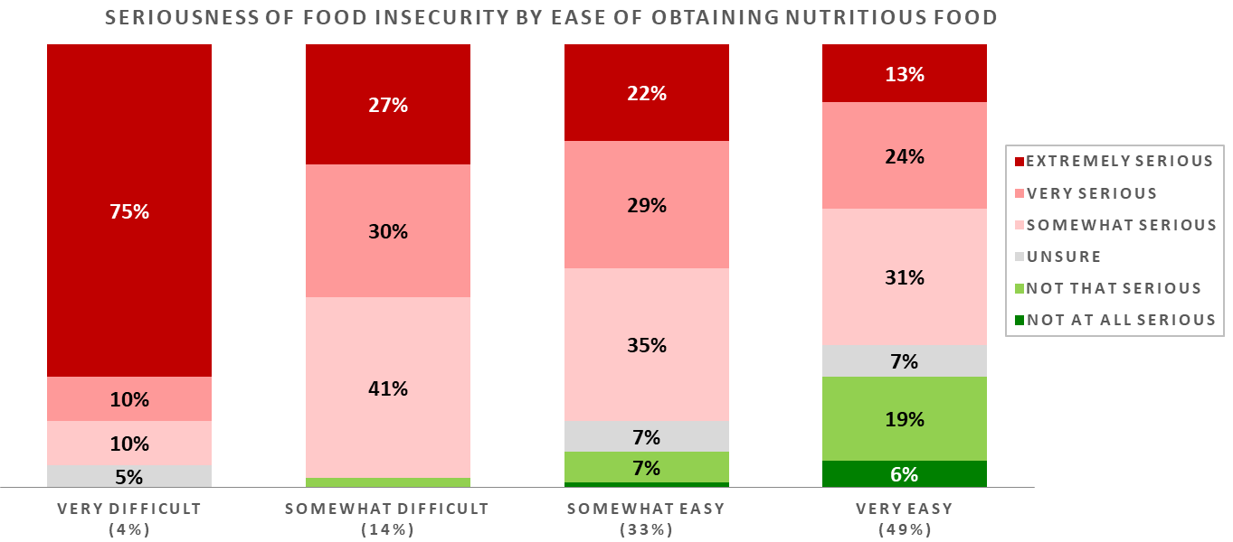
A Wide Majority Think Food Insecurity is a Problem Locally
And nearly half say it’s very or extremely serious
Just 16% think it’s not that or not at all serious
Views on the problem’s severity mainly come down – again -- to personal experience
The easier it is for a resident to get healthy/affordable food, the less likely they are to see food insecurity as a serious problem and vice versa
And 3/4 who find it very difficult to get nutritious food think food insecurity is extremely serious.
That said, even those who have no problem getting their own food generally see food insecurity in San Diego as somewhat serious.

Slide 14
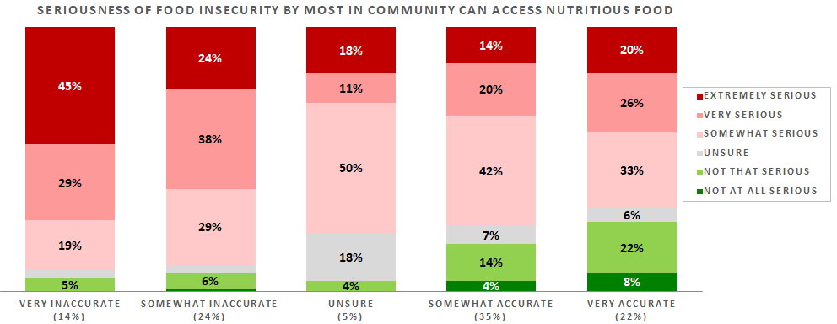
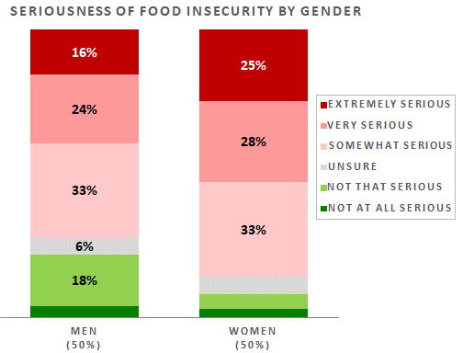
Food Deserts also Play an Important Role
Most living in one believe food insecurity is at least a very serious problem
Sentiment is less intense among those who believe their neighbors have easy access to food
Women are far more likely to feel food insecurity has reached critical levels
Whites and AAPI residents tend to think the problem is less severe
Cost of living weighs on the minds of some
Of those saying it’s the county’s most important issue, 43% believe food insecurity is extremely serious
Registered voters also typically think it’s a bigger problem.

Slide 15
A Closer Look at Our Ethnic Communities
The AAPI community regards food insecurity as less serious
African Americans see food insecurity as more serious
Perceptions among Latinos are in-line with those of the larger population.

Slide 16
What Should Government Do?

Slide 17
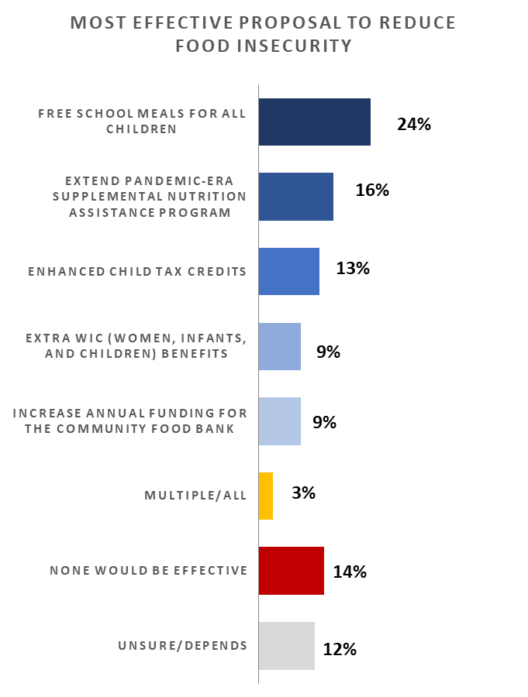
Three-Quarters Want Government Action
Free school meals for all children is most popular
But not a clear-cut standout
Favorite among AAPI residents
16% want to extend COVID-era SNAP benefits
Latinos are bigger fans of this approach
Enhanced child tax credits are the choice of 13%
Much more appealing to those 40 or younger
9% would like to see extra WIC benefits
2x as many folks in City Heights, the College Area, and La Mesa back this
Another 9% feel increasing annual funding for food banks is best
14% don’t think any of the proposals will work
Non-Democrats dealing with serious financial hardship are 2x as likely to reject all the proposals.

Slide 18
A Closer Look at Our Ethnic Communities
More Blacks see government programs to address food insecurity as effective
AAPI folks disproportionately favor free school meals for all children
Latinos are partial to extending SNAP benefits, but rarely feel funding for food banks is the best approach.

Slide 19
What are San Diegans Willing to Do?

Slide 20
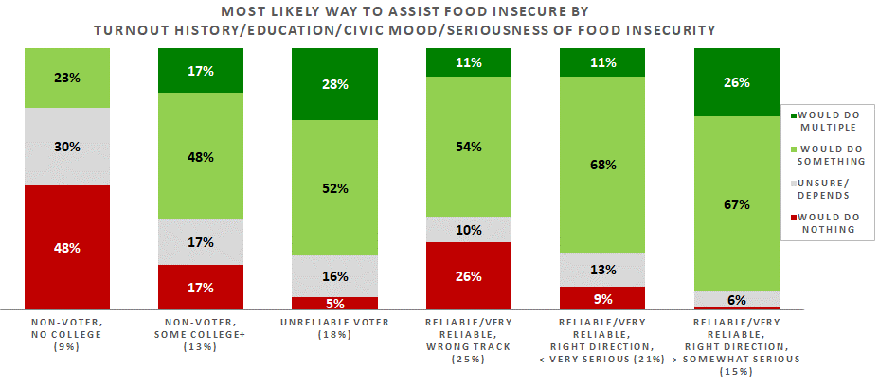
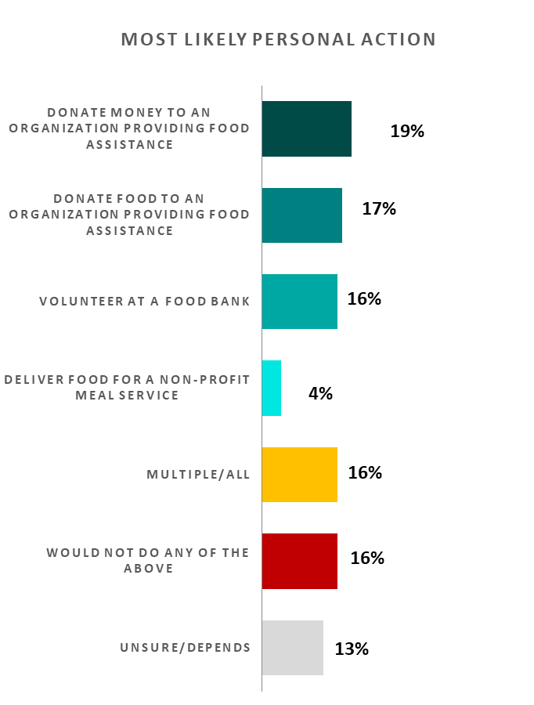
71% Would Personally Help Food Insecure Residents
And 16% would engage in multiple efforts
Upbeat residents who take food insecurity very seriously and vote reliably are the most service-minded
There’s much less enthusiasm from dissatisfied voters
A sizeable 1-in-6 wouldn’t volunteer or donate
Non-registrants who didn’t attend college are least into assisting
Donations are slightly preferred over other ways of helping
Common choice among seniors aged 74+
Donating food is frequently preferred by Democrats
Volunteering at a food bank is also popular
Delivering food for a non-profit meal service requires the largest personal commitment and only 4% are attracted to that.

Slide 21
A Closer Look at Our Ethnic Communities
None in the AAPI community (in our survey) are inclined to deliver food
Blacks are more likely than others to deliver food
And generally more likely to do something
Only 5% rule out taking any action.

Slide 22
Thank You!

Slide 23
Public Opinion · Public Policy · Organizations · Campaigns
1987 – Founded in San Diego
1988 – Phonecenters established in Riverside, CA and San Diego
1990 – Phonecenters established in Reno, NV and San Diego
1992 – Predictive dialing installed to double interviewing capacity; CERC calls San Diego Mayor’s race
1993 – "The Edge" newsletter launches
1998 – Qualitative focus groups introduced
2000 – CERC calls San Diego Mayor’s race
2003 – KPBS/Competitive Edge Research Poll and annual Super Bowl poll launched
2004 – CERC calls San Diego Mayor’s race (x2)
2005 – CERC calls San Diego Mayor’s race (x2)
2006 – SDIPR/CERC Opinion Barometer launched; Ballot measures paper presented at AAPOR Conference
2008 – CERC calls San Diego Mayor’s race; Convenes post-election summit @ USD
2009 – Interviewer effects paper presented at AAPOR Conference
2010 – Web-based interviewing and custom panels introduced
2012 – Dial-testing introduced; CERC calls San Diego Mayor’s race (x2)
2013 – CERC calls San Diego Mayor’s race; Business Forecast survey launched
2014 – CERC calls San Diego Mayor’s race
2016 – CERC calls San Diego Mayor’s race
2017 – Phonecenter established in El Paso, TX
2018 – CERC calls CA Governor’s race (x2)
2019 – Ballot measure wording paper presented at AAPOR Conference
2020 – Incumbent viability paper accepted for presentation at AAPOR Conference
2022 – San Diego County Issues Barometer launched
John Nienstedt, MA Political Science: President
Member, American Association for Public Opinion Research
SBA Entrepreneurial Success Award (2000)
Pollster of the year (x7)
Rachel Lawler, MA Political Science: Research Analyst
Member, American Association for Public Opinion Research
Ronald Zavala: Director of Operations
James Iwu: Research Assistant

