Slide 1
Public Opinion · Public Policy · Organizations · Campaigns
1987 – Founded in San Diego
1988 – Phonecenters established in Riverside, CA and San Diego
1990 – Phonecenters established in Reno, NV and San Diego
1992 – Predictive dialing installed to double interviewing capacity; CERC calls San Diego Mayor’s race
1993 – "The Edge" newsletter launches
1998 – Qualitative focus groups introduced
2000 – CERC calls San Diego Mayor’s race
2003 – KPBS/Competitive Edge Research Poll and annual Super Bowl poll launched
2004 – CERC calls San Diego Mayor’s race (x2)
2005 – CERC calls San Diego Mayor’s race (x2)
2006 – SDIPR/CERC Opinion Barometer launched; Ballot measures paper presented at AAPOR Conference
2008 – CERC calls San Diego Mayor’s race; Convenes post-election summit @ USD
2009 – Interviewer effects paper presented at AAPOR Conference
2010 – Web-based interviewing and custom panels introduced
2012 – Dial-testing introduced; CERC calls San Diego Mayor’s race (x2)
2013 – CERC calls San Diego Mayor’s race; Business Forecast survey launched
2014 – CERC calls San Diego Mayor’s race
2016 – CERC calls San Diego Mayor’s race
2017 – Phonecenter established in El Paso, TX
2018 – CERC calls CA Governor’s race (x2)
2019 – Ballot measure wording paper presented at AAPOR Conference
2020 – Incumbent viability paper accepted for presentation at AAPOR Conference
2022 – San Diego County Issues Barometer launched
John Nienstedt, MA Political Science: President
Member, American Association for Public Opinion Research
Insights Association
SBA Entrepreneurial Success Award (2000)
Pollster of the year (x7)
Rachel Lawler, MA Political Science: Research Analyst
Member, American Association for Public Opinion Research
Ronald Zavala: Director of Operations
James Iwu: Research Assistant

Slide 2
San Diego County Issues Barometer March 2023
Transit Funding Proposals Opposed, as SANDAG, New Gas Vehicle Ban Roundly Criticized
Mood Remains Unsettled as Homelessness is Top Issue Again

Slide 3
Summary
Research Objectives: 1) Document trends in civic mood and important issues
2) Explore SANDAG, public transportation, and plans to expand it
Sample Size: n=508
Margin of Sampling Error: ± 4.3%
Confidence Level: 95%
Sample Methodology: Simple random sampling from listed sample
Jurisdiction: San Diego County
Eligibility: Adult residents
Interview Methods: Telephone (including cell phones), e-mail push-to-web, text push-to-web
Field Dates: March 1-7, 2023
Field Facility: Competitive Edge Research, El Paso TX
Project Director: John Nienstedt, Sr.
Research Analyst: Rachel Lawler
Research Assistant: James Iwu

Slide 4
Trends
Page | 4

Slide 5
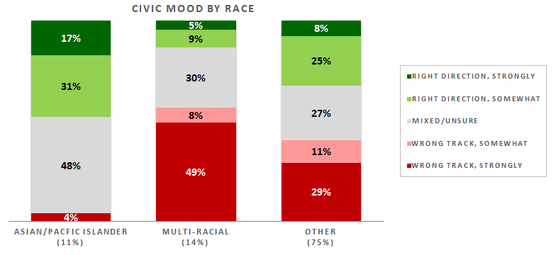
The Mood Remains Unsettled
32% think things are going in the right direction
Outweighed by residents who say we’re on the wrong track
And negative sentiment is more robust
Mood is now mainly a product of race
AAPI residents are most upbeat
Multi-racial residents are the least pleased
Other communities are more divided.
Page | 5

Slide 6
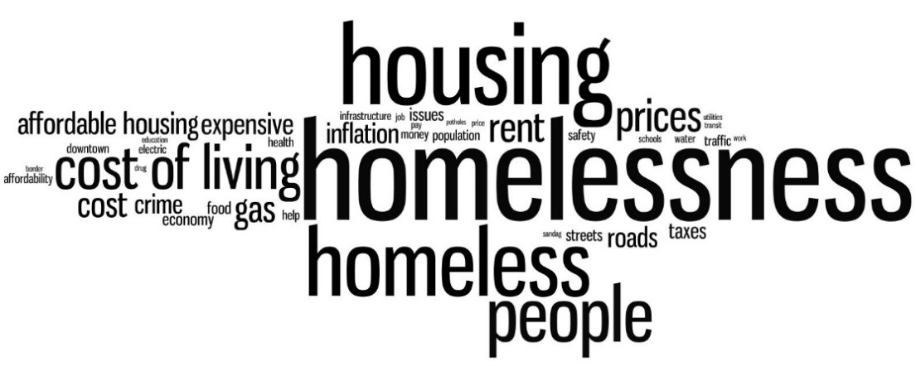
Top Concerns are Unchanged
Homelessness continues to outpace other issues by double digits
More problematic among voters than non-registrants
Makes this politically incendiary
Housing affordability remains a very substantial concern
9% focus on cost of living, but those with no college are far more impacted
Jobs/economy doubled vs December
Utility costs have spiked as an issue
Men, north county residents, and whites place more emphasis on them
Housing availability is at 4%
Crime concerns, worries over inflation and problems with gas prices have lessened.
Page | 6

Slide 7
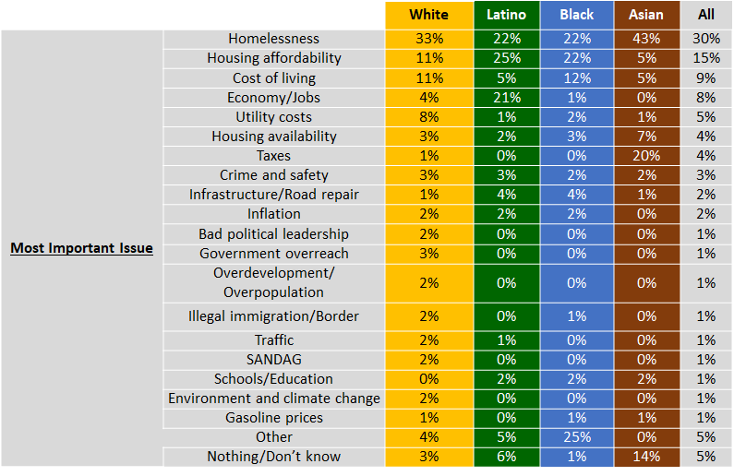
A Closer Look at Our Ethnic Communities
Mood in the Latino community is roughly comparable to the county as a whole
African Americans are slightly more upbeat
The AAPI community is much more satisfied with the county’s direction
More AAPI residents emphasize taxes
But rarely cite housing affordability
Housing affordability is more top-of-mind for Latinos
Even tops homelessness
Economy is also a big issue
Utility costs and taxes are less important
African Americans are less focused on the economy.

Slide 8
Public Transportation Usage
Page | 8

Slide 9
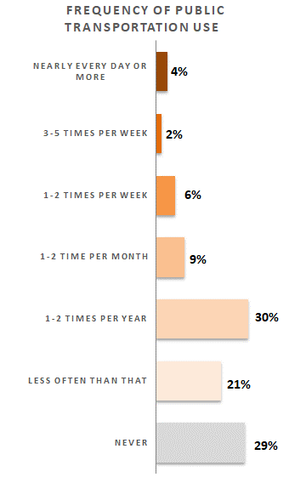
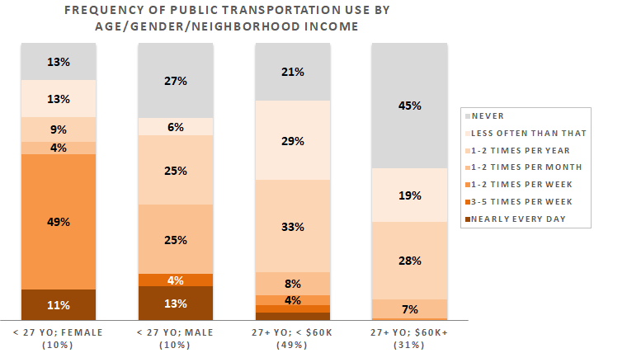
Just 6% Take Public Transit > 2 Times/Week
Roughly 160,000 residents would have a tough time living w/o it
12% are weekly+ users
We’ll call these 320,000 “regular riders”
21% use it at least monthly
That’s about 570,000 monthly+ riders
> 780,000 residents (29%) have never used county public transit
And another 570,000 almost never use it
Half of all county adults don’t use the current system at all
However, there are astounding differences by age
Those < 27 use it more regularly
Suggests SDSU and UCSD trolleys draw riders
Especially staggering ridership among women
Ridership drops among adults 27+
Although weekly usage is higher in lower income areas.
v
Page | 9

Slide 10
A Closer Look at Our Ethnic Communities
Ethnic communities generally rely more on San Diego’s public transit
Black residents are 5x more likely to use public transit multiple days a week than others
But they’re also more likely to have never used it
Latinos are more likely to have used San Diego’s public transport system at least once
The Asian community contains more weekly riders.

Slide 11
Outlawing the Sale of New Gas-Powered Vehicles
Page | 11

Slide 12
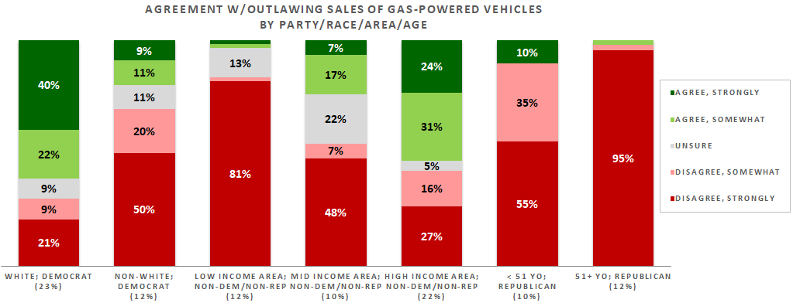
San Diegans Reject the 2035 Ban
6-in-10 disagree with California Air Resources Board’s decision
47% strongly so
One-third agree with the ban, but support is lukewarm
It’s a partisan issue
Republicans are vehemently opposed
Almost all those 50+ strongly disagree
Democrat minorities, NPP, minor party, and non-registrants in mid- and lower- income areas side with the GOP(!)
Only 2 groups agree with the ban:
White Democrats
Other non-Republicans in upper income neighborhoods.
Page | 12

Slide 13
A Closer Look at Our Ethnic Communities
There’s distaste for the ban across AAPI, Black, and Latino communities.

Slide 14
SANDAG Job Performance
Page | 14

Slide 15
SANDAG and Its Plan
SANDAG defines itself as “both a metropolitan planning organization and a council of governments”
It “brings together local decision-makers to develop solutions to regional issues including improving equity, transportation, air quality, clean energy, economic development, goods movement, public health, public safety, housing, and more.”
Page | 15

Slide 16
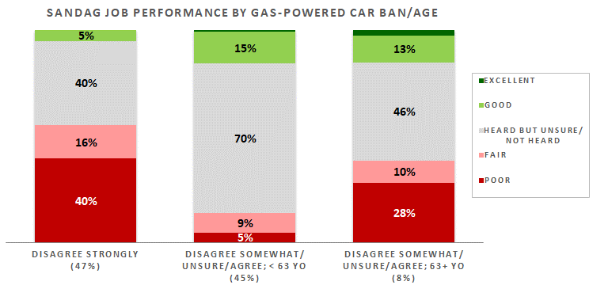
SANDAG Struggles
Most know of SANDAG but only half can rate it
Latinos are less familiar
Just 11% say the organization is doing an excellent or good job
36% give it an only fair or poor rating
Performance ratio = dismal 1:3.3
Views are tightly tied to the gas vehicle ban
Those strongly against it are much more critical
The rest aren’t fans per se
They often can’t rate it
But those 64+ offer harsher reviews
The implication is SANDAG is aligned with the ban
“This is the kind of thing SANDAG does”
Doesn’t sit well with lots of folks.
Page | 16

Slide 17
A Closer Look at Our Ethnic Communities
Most Latinos are unaware of SANDAG
None of the AAPI residents (in our sample) think SANDAG does an excellent job
Instead, they often know about the Association but cannot rate it
African American residents are also critical
But 21% like its performance.
 |  | White | Latino | Black | Asian | All
SANDAG job performance | Never heard | 17% | 55% | 23% | 9% | 28%
 | Poor | 31% | 9% | 14% | 4% | 23%
 | Only Fair | 12% | 11% | 31% | 20% | 13%
 | Heard but unsure | 25% | 16% | 11% | 67% | 26%
 | Good | 13% | 9% | 18% | 1% | 10%
 | Excellent | 1% | 1% | 3% | 0% | 1%

Slide 18
SANDAG’S Plan for a New Public Transportation Network
Page | 18

Slide 19
SANDAG’s Plan
Its promoting a new $165 billion public transport network
This plan is largely based on bus lanes and trolley access across the county
Would be free for residents.
Page | 19

Slide 20
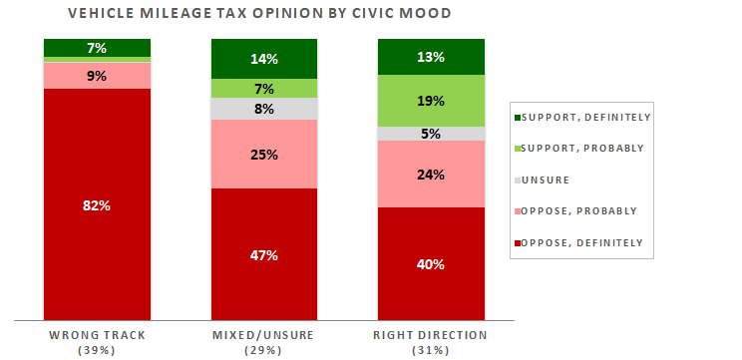
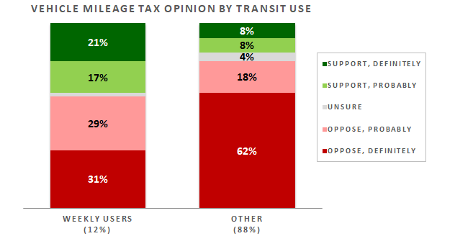
A 4 Cent Per Mile Tax is Wildly Unpopular
77% are opposed
Most strongly so
Selling residents on more fees will be very challenging
18 to 24-year-olds are on board
But opposition rises with age
County critics overwhelmingly oppose it, but happier folks are less upset by the VMT
It’s not the right time
But it’s difficult to see any “right time” on the horizon
Unincorporated area residents are decidedly against it
Weekly transit riders are twice as supportive as moderate- and non-users
But even they’d pay the VMT sometimes
The proposal even struggles with Democratic women and college-educated
Only the 1% who say SANDAG does an excellent job support the tax.
Page | 20

Slide 21
A Closer Look at Our Ethnic Communities
All ethnic communities oppose the VMT
Though Asians and Blacks are less critical.

Slide 22
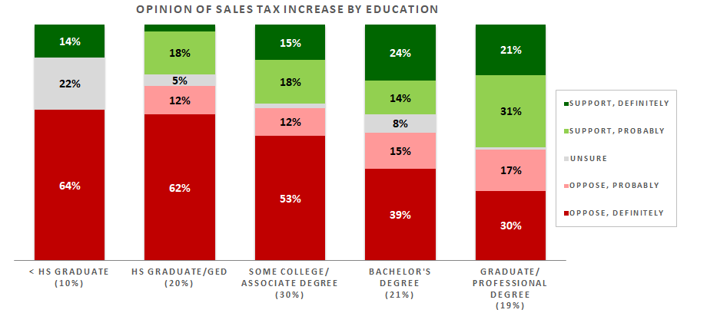
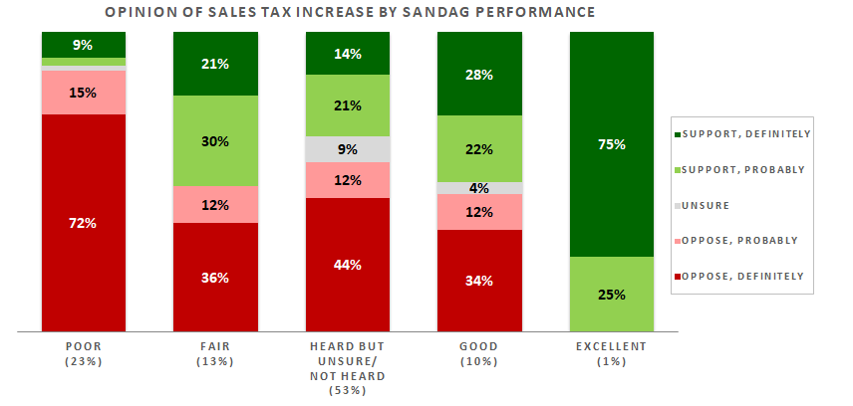
A Half-Cent Sales Tax Increase Encounters Less Resistance…
…but it’s also unacceptable
Nearly half strongly oppose it
Most who are happy with the county’s direction are supportive
But the reverse is more true
Advanced degree holders are in favor
Support drops as education levels decline
National City residents are a pocket of strong support
Republicans gag at the idea
Non-partisans and minor party voters join them
Democrats like it a lot more
But only 25% definitely want it
Women 55+ are 2x more supportive than others
SANDAG fans generally like the proposal…
…but critics and those unaware of it reject the tax.
Page | 22

Slide 23
A Closer Look at Our Ethnic Communities
Latinos more stridently oppose sales tax increase than residents overall
Views of AAPI and Black folks reflect those of the wider populace.

Slide 24
Thank You!

Slide 25
Public Opinion · Public Policy · Organizations · Campaigns
1987 – Founded in San Diego
1988 – Phonecenters established in Riverside, CA and San Diego
1990 – Phonecenters established in Reno, NV and San Diego
1992 – Predictive dialing installed to double interviewing capacity; CERC calls San Diego Mayor’s race
1993 – "The Edge" newsletter launches
1998 – Qualitative focus groups introduced
2000 – CERC calls San Diego Mayor’s race
2003 – KPBS/Competitive Edge Research Poll and annual Super Bowl poll launched
2004 – CERC calls San Diego Mayor’s race (x2)
2005 – CERC calls San Diego Mayor’s race (x2)
2006 – SDIPR/CERC Opinion Barometer launched; Ballot measures paper presented at AAPOR Conference
2008 – CERC calls San Diego Mayor’s race; Convenes post-election summit @ USD
2009 – Interviewer effects paper presented at AAPOR Conference
2010 – Web-based interviewing and custom panels introduced
2012 – Dial-testing introduced; CERC calls San Diego Mayor’s race (x2)
2013 – CERC calls San Diego Mayor’s race; Business Forecast survey launched
2014 – CERC calls San Diego Mayor’s race
2016 – CERC calls San Diego Mayor’s race
2017 – Phonecenter established in El Paso, TX
2018 – CERC calls CA Governor’s race (x2)
2019 – Ballot measure wording paper presented at AAPOR Conference
2020 – Incumbent viability paper accepted for presentation at AAPOR Conference
2022 – San Diego County Issues Barometer launched
John Nienstedt, MA Political Science: President
Member, American Association for Public Opinion Research
Insights Association
SBA Entrepreneurial Success Award (2000)
Pollster of the year (x7)
Rachel Lawler, MA Political Science: Research Analyst
Member, American Association for Public Opinion Research
Ronald Zavala: Director of Operations
James Iwu: Research Assistant

