Slide 1
Public Opinion · Public Policy · Organizations · Campaigns
1987 – Founded in San Diego
1988 – Phonecenters established in Riverside, CA and San Diego
1990 – Phonecenters established in Reno, NV and San Diego
1992 – Predictive dialing installed to double interviewing capacity; CERC calls San Diego Mayor’s race
1993 – "The Edge" newsletter launches
1998 – Qualitative focus groups introduced
2000 – CERC calls San Diego Mayor’s race
2003 – KPBS/Competitive Edge Research Poll and annual Super Bowl poll launched
2004 – CERC calls San Diego Mayor’s race (x2)
2005 – CERC calls San Diego Mayor’s race (x2)
2006 – SDIPR/CERC Opinion Barometer launched; Ballot measures paper presented at AAPOR Conference
2008 – CERC calls San Diego Mayor’s race; Convenes post-election summit @ USD
2009 – Interviewer effects paper presented at AAPOR Conference
2010 – Web-based interviewing and custom panels introduced
2012 – Dial-testing introduced; CERC calls San Diego Mayor’s race (x2)
2013 – CERC calls San Diego Mayor’s race; Business Forecast survey launched
2014 – CERC calls San Diego Mayor’s race
2016 – CERC calls San Diego Mayor’s race
2017 – Phonecenter established in El Paso, TX
2018 – CERC calls CA Governor’s race (x2)
2019 – Ballot measure wording paper presented at AAPOR Conference
2020 – Incumbent viability paper accepted for presentation at AAPOR Conference
2022 – San Diego County Issues Barometer launched
John Nienstedt, MA Political Science: President
Member, American Association for Public Opinion Research
Insights Association
SBA Entrepreneurial Success Award (2000)
Pollster of the year (x7)
Rachel Lawler, MA Political Science: Research Analyst
Member, American Association for Public Opinion Research
Ronald Zavala: Director of Operations
James Iwu: Research Assistant

Slide 2
San Diego County Issues Barometer April 2023
Taxes Too High… or Too Low? Depends on the Tax and Who’s Being Taxed
Fed’s Income Tax is Less Onerous than State’s, but Property Tax Burden is Worst of All
Split on Tax Policy to Spur Growth, Little Consensus on Imposing Net Worth Tax

Slide 3
Summary
Research Objectives: 1) Measure tax burden perceptions
2) Explore preferences for fueling economic growth
3) Gauge support for a statewide net worth tax on the wealthy
Sample Size: n=508
Margin of Sampling Error: ± 4.3%
Confidence Level: 95%
Sample Methodology: Simple random sampling from listed sample
Jurisdiction: San Diego County
Eligibility: Adult residents
Interview Methods: Telephone (including cell phones), e-mail push-to-web, text push-to-web
Field Dates: March 1-7, 2023
Field Facility: Competitive Edge Research, El Paso TX
Project Director: John Nienstedt, Sr.
Research Analyst: Rachel Lawler
Research Assistant: James Iwu

Slide 4
Federal Income Taxes
Page | 4

Slide 5
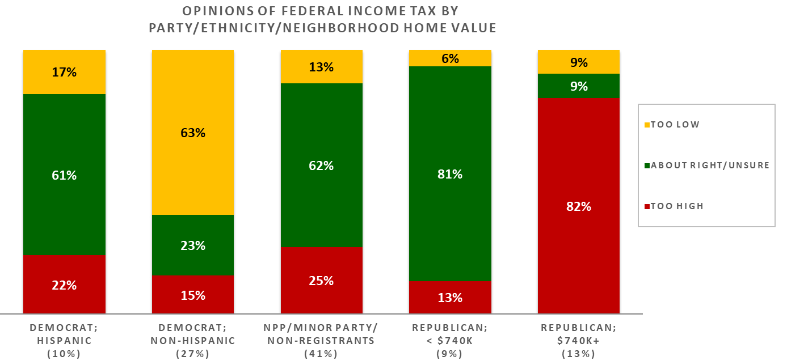
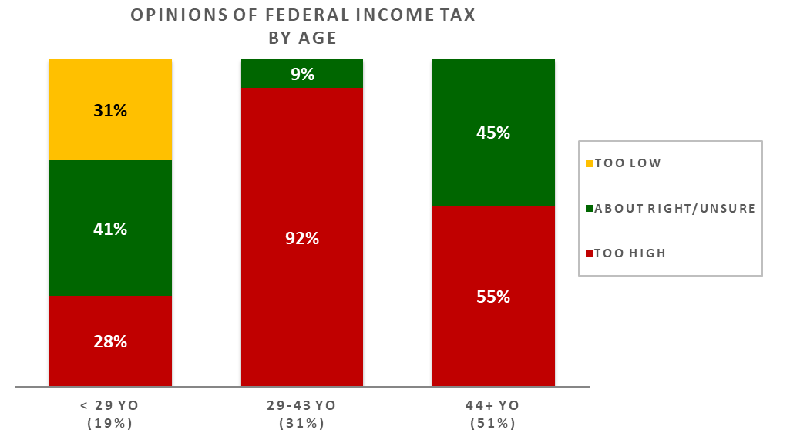
Too Much? Depends on who We’re Talking About
Middle-income earners pay > their fair share
Driven by those in their late-20s to early-40s
Unsure
23%
5%
15%
Older residents mostly agree
Young adults are the ones pushing back
44% say taxes on low-income earners are too high
Many are unsure about taxes on lower-income HHs
Less sympathy for high earners
This is where partisan fissures appear
Non-Hispanic Democrats think the wealthy are undertaxed
Latino Democrats think those taxes are about right
Voters not registered with a major party and non-registrants also feel the wealthy are taxed appropriately
Republicans in mid to upscale neighborhoods believe the feds overtax high earners
Those in less expensive areas think high earners are taxed correctly.
Page | 5

Slide 6
A Closer Look at Our Ethnic Communities
Latinos more often say lower earners are paying a fair amount
Less likely than others to say taxes on middle income earners are too high
Asian Americans and Pacific Islanders (AAPI) almost all believe taxes are too high on mid-level earners
Opinions among Blacks align with those of the wider population.
 |  |  | White | Latino | Black | Asian | All
Opinion of federal income tax | High-income earners | Too high | 20% | 26% | 32% | 21% | 28%
 |  | About right/unsure | 49% | 61% | 32% | 42% | 47%
 |  | Too low | 31% | 13% | 36% | 37% | 25%
 | Middle-income earners | Too high | 61% | 55% | 59% | 93% | 62%
 |  | About right/unsure | 38% | 27% | 37% | 7% | 32%
 |  | Too low | 1% | 18% | 5% | 0% | 6%
 | Low-income earners | Too high | 53% | 28% | 42% | 64% | 44%
 |  | About right/unsure | 42% | 66% | 52% | 30% | 50%
 |  | Too low | 5% | 6% | 6% | 6% | 6%

Slide 7
State Income Taxes
Page | 7

Slide 8
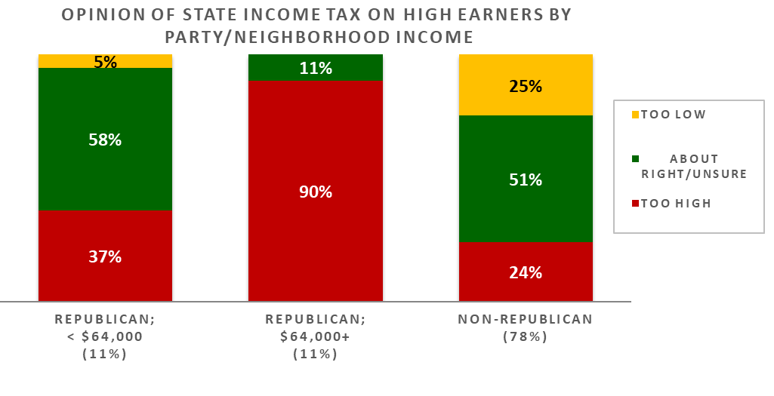
California’s Brand is as a “High Tax” State
Most think low- and middle-income earners pay too much
Unsure
14%
5%
16%
Reliably voting Democrats are the only ones who think mid-income earners aren’t overtaxed
Less uncertainty about low wage earners
A bit more empathy for higher earners
1/3 think they pay a fair amount
32% think their state taxes are too high
Nearly all Republicans in affluent neighborhoods feel that way
Though lower income Republicans mostly think high income earners are taxed correctly
Just a quarter of even the non-Republicans think California is too hard on its wealthy residents.
Page | 8

Slide 9
A Closer Look at Our Ethnic Communities
AAPI residents overwhelmingly think California overtaxes middle-income earners
Same goes for low-income earners
Also tend to believe state taxes on the wealthy are lower than they should be
Latinos are more convinced low-income earners are paying their fair share
Views among African Americans mirror those of the general populace.
 |  |  | White | Latino | Black | Asian | All
Opinion of state income tax | High-income earners | Too high | 28% | 26% | 32% | 21% | 28%
 |  | About right/unsure | 49% | 61% | 32% | 42% | 47%
 |  | Too low | 22% | 13% | 36% | 37% | 25%
 | Middle-income earners | Too high | 66% | 55% | 59% | 93% | 62%
 |  | About right/unsure | 33% | 27% | 37% | 7% | 32%
 |  | Too low | 1% | 18% | 5% | 0% | 6%
 | Low-income earners | Too high | 57% | 28% | 42% | 64% | 44%
 |  | About right/unsure | 40% | 66% | 52% | 30% | 50%
 |  | Too low | 4% | 6% | 6% | 6% | 6%

Slide 10
Property Taxes
Page | 10

Slide 11
61% Think Property Taxes are Too High
Virtually no one says they opposite
One-quarter think they are about right
Unsure
13%
Less educated non-Whites are in the “too high” camp
Non-Democrats with more education agree
Democrats are less upset
Whites are torn between “too high” and “about right”
But eastern suburban folks often say property taxes are excessive
White GOPers living elsewhere agree
Their non-GOP counterparts are OK with current levies.
Page | 11

Slide 12
A Closer Look at Our Ethnic Communities
More African Americans and Latinos regard property taxes as being too high
Opinions among AAPI residents reflect those of all San Diegans.
 |  | White | Latino | Black | Asian | All
Opinion of property taxes | Too high | 48% | 77% | 79% | 63% | 61%
 | About right/unsure | 50% | 23% | 21% | 38% | 26%
 | Too low | 2% | 0% | 0% | 0% | 1%

Slide 13
What’s the Best Way to Promote Economic Growth?
Page | 13

Slide 14
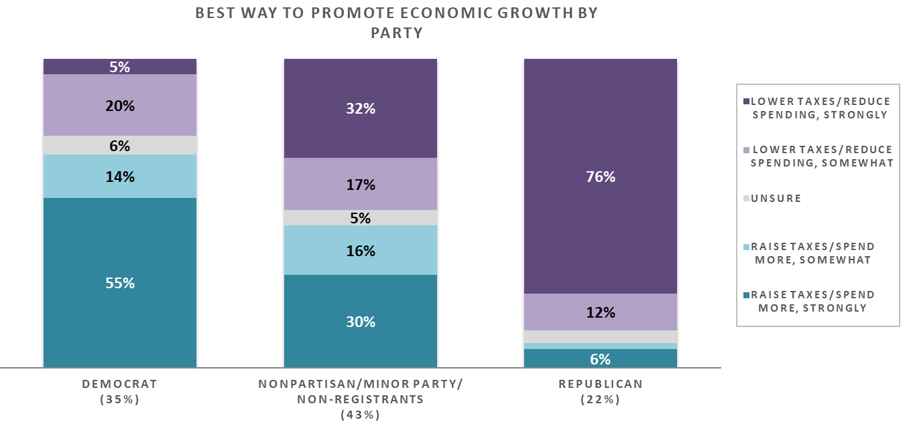
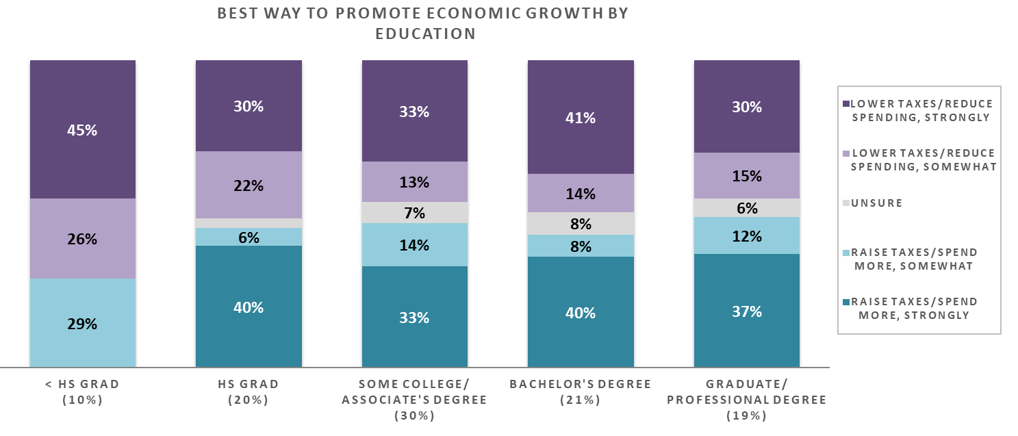
San Diegans are Sharply Divided
Half prefer lowering taxes and spending
46% think taxes, spending should be higher
An equal 1/3 are strongly in each camp
Best Way to Promote Economic Growth in the US
Preferences primarily come down to partisanship
Older San Diegans – particularly men 55+ – are also in this bucket
Support for tax cuts wanes as education rises.
“Multi-racial” folks are avid proponents of cuts
Residents between I-8 and SR-52 are 2x more likely to want cuts
Page | 14

Slide 15
A Closer Look at Our Ethnic Communities
Latinos are stronger proponents of raising taxes and government spending
Asian Americans are a bit stronger on reducing taxes and spending
Preferences among African Americans are on par with the broader population.
 |  | White | Latino | Black | Asian | All
Best way to promote economic growth in the US | Raise taxes/spend more, strongly | 34% | 42% | 32% | 21% | 33%
 | Raise taxes/spend more, somewhat | 10% | 13% | 18% | 21% | 12%
 | Unsure | 8% | 2% | 4% | 5% | 5%
 | Lower taxes/reduce spending, somewhat | 16% | 15% | 25% | 11% | 17%
 | Lower taxes/reduce spending, strongly | 32% | 28% | 21% | 41% | 33%

Slide 16
Should California Impose a Net Worth Tax on Uber-Wealthy Households?
Page | 16

Slide 17
Residents Flirt with Support
More agree with the idea of imposing a wealth tax on Californians with net worths of $50 million+
But support doesn’t reach a majority
39% think it’s a bad idea
Views on Imposing a net worth tax on the Wealthiest Californians
Views largely fall along partisan lines
Democrats are mostly pro-tax
Most GOPers are opposed
Others lean slightly supportive.
Page | 17

Slide 18
More Support for Higher Taxes among Young Women and Southsiders
Men are typically anti-tax, while women more open to the proposal
Women < 35 especially keen on the idea
Residents south of I-8 are more supportive than their northern neighbors
Support grows among the highly-educated
Latinos are not solidly in either camp
But they lean toward support.
Page | 18

Slide 19
A Closer Look at Our Ethnic Communities
Latinos are 3x more likely than others to be unsure or prefer neither wealth tax argument
But side with pro-tax Smith half the time
Blacks heavily favor the net worth tax
The AAPI community’s views are more polarized
But are the most opposed group.
 |  | White | Latino | Black | Asian | All
Views on imposing a net worth tax on the wealthiest Californians | Smith (pro tax), strongly | 32% | 29% | 39% | 35% | 31%
 | Smith, somewhat | 16% | 22% | 29% | 6% | 17%
 | Unsure/Neither | 8% | 27% | 11% | 4% | 10%
 | Jones, somewhat | 12% | 11% | 7% | 15% | 11%
 | Jones (anti tax), strongly | 33% | 12% | 14% | 41% | 28%

Slide 20
Thank You!

Slide 21
Public Opinion · Public Policy · Organizations · Campaigns
1987 – Founded in San Diego
1988 – Phonecenters established in Riverside, CA and San Diego
1990 – Phonecenters established in Reno, NV and San Diego
1992 – Predictive dialing installed to double interviewing capacity; CERC calls San Diego Mayor’s race
1993 – "The Edge" newsletter launches
1998 – Qualitative focus groups introduced
2000 – CERC calls San Diego Mayor’s race
2003 – KPBS/Competitive Edge Research Poll and annual Super Bowl poll launched
2004 – CERC calls San Diego Mayor’s race (x2)
2005 – CERC calls San Diego Mayor’s race (x2)
2006 – SDIPR/CERC Opinion Barometer launched; Ballot measures paper presented at AAPOR Conference
2008 – CERC calls San Diego Mayor’s race; Convenes post-election summit @ USD
2009 – Interviewer effects paper presented at AAPOR Conference
2010 – Web-based interviewing and custom panels introduced
2012 – Dial-testing introduced; CERC calls San Diego Mayor’s race (x2)
2013 – CERC calls San Diego Mayor’s race; Business Forecast survey launched
2014 – CERC calls San Diego Mayor’s race
2016 – CERC calls San Diego Mayor’s race
2017 – Phonecenter established in El Paso, TX
2018 – CERC calls CA Governor’s race (x2)
2019 – Ballot measure wording paper presented at AAPOR Conference
2020 – Incumbent viability paper accepted for presentation at AAPOR Conference
2022 – San Diego County Issues Barometer launched
John Nienstedt, MA Political Science: President
Member, American Association for Public Opinion Research
Insights Association
SBA Entrepreneurial Success Award (2000)
Pollster of the year (x7)
Rachel Lawler, MA Political Science: Research Analyst
Member, American Association for Public Opinion Research
Ronald Zavala: Director of Operations
James Iwu: Research Assistant

