Slide 1
Public Opinion · Public Policy · Organizations · Campaigns
1987 – Founded in San Diego
1988 – Phonecenters established in Riverside, CA and San Diego
1990 – Phonecenters established in Reno, NV and San Diego
1992 – Predictive dialing installed to double interviewing capacity; CERC calls San Diego Mayor’s race
1993 – "The Edge" newsletter launches
1998 – Qualitative focus groups introduced
2000 – CERC calls San Diego Mayor’s race
2003 – KPBS/Competitive Edge Research Poll and annual Super Bowl poll launched
2004 – CERC calls San Diego Mayor’s race (x2)
2005 – CERC calls San Diego Mayor’s race (x2)
2006 – SDIPR/CERC Opinion Barometer launched; Ballot measures paper presented at AAPOR Conference
2008 – CERC calls San Diego Mayor’s race; Convenes post-election summit @ USD
2009 – Interviewer effects paper presented at AAPOR Conference
2010 – Web-based interviewing and custom panels introduced
2012 – Dial-testing introduced; CERC calls San Diego Mayor’s race (x2)
2013 – CERC calls San Diego Mayor’s race; Business Forecast survey launched
2014 – CERC calls San Diego Mayor’s race
2016 – CERC calls San Diego Mayor’s race
2017 – Phonecenter established in El Paso, TX
2018 – CERC calls CA Governor’s race (x2)
2019 – Ballot measure wording paper presented at AAPOR Conference
2020 – Incumbent viability paper accepted for presentation at AAPOR Conference
2022 – San Diego County Issues Barometer launched
John Nienstedt, MA Political Science: President
Member, American Association for Public Opinion Research
Insights Association
SBA Entrepreneurial Success Award (2000)
Pollster of the year (x7)
Rachel Lawler, MA Political Science: Research Analyst
Member, American Association for Public Opinion Research
Ronald Zavala: Director of Operations
James Iwu: Research Assistant

Slide 2
San Diego County Issues Barometer May 2023
Many San Diegans Fear More Growth, but Housing Affordability Concerns are Near Universal
Building Single-family Homes and Building Rental Units Vie with Rent Control as Solutions
Big Support for Growth in Transit-oriented Areas; Taxes for Low-income Housing are Opposed

Slide 3
Summary
Research Objectives: 1) Explore housing policies
Sample Size: n=508
Margin of Sampling Error: ± 4.3%
Confidence Level: 95%
Sample Methodology: Simple random sampling from listed sample
Jurisdiction: San Diego County
Eligibility: Adult residents
Interview Methods: Telephone (including cell phones), e-mail push-to-web, text push-to-web
Field Dates: March 1-7, 2023
Field Facility: Competitive Edge Research, El Paso TX
Project Director: John Nienstedt, Sr.
Research Analyst: Rachel Lawler
Research Assistant: James Iwu

Slide 4
Residential Over-Development
Page | 4

Slide 5
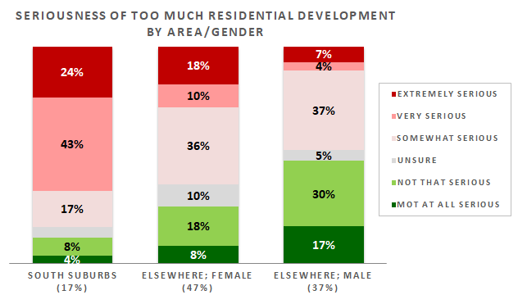
The Old “Growth Wars” Die Hard
Most think overdevelopment is a serious problem
And 3-in-10 think it’s extremely or very serious
Only one-third are unconcerned
Not good news for those who believe more housing = solution to the affordability crisis
South suburbanites are on high alert
Reflects the recent development in there
Women elsewhere say it’s at least very serious > 2x as often as men.
Page | 5

Slide 6
A Closer Look at Our Ethnic Communities
Latinos more often believe residential over-development is a very or extremely serious problem
Views among Asian and Pacific Islander Americans and African Americans align with those of all San Diegans.

Slide 7
Housing Affordability
Page | 7

Slide 8
The San Diego Market is in Crisis
> 8-in-10 think housing affordability is at least a very serious issue
And most – 55% – say it’s extremely serious
Every demographic thinks the local market is in crisis
One-quarter say over-development as at least very serious and think the same about housing affordability
Often south suburbanites and residents of other dense neighborhoods
They acknowledge costs are problematic…
…but fear more units even they offer some relief
It’s difficult to imagine a solution for them other than some form of price controls.
Page | 8

Slide 9
A Closer Look at Our Ethnic Communities
Similar shares of African Americans, Asian Americans, and Latinos consider housing affordability to be a highly serious problem
However, Latinos are far more in the double-bind of fearing both residential development and a housing affordability crisis.

Slide 10
Preferred Approach for Addressing Housing Affordability
Page | 10

Slide 11
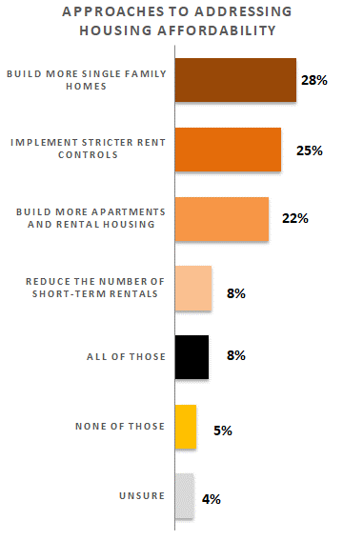
Residents Divide Between Three Approaches…
…but half back building more single-family (SF) homes or apartment/rental units
One-quarter prefer stricter rent control
Few think reducing short-term rentals is best
Political party is a key preference driver
Republicans lean toward SF homes
So do Democrats, but they also like rental housing and rent control
SF homes are embraced across age groups…
…except among seniors who prefer building more rental housing
…and 18 to 24 year-olds who are bigger fans of rent control
Rent control is more favored by ethnic communities than Whites
Rent control is most popular with those who see affordability as critical to SD’s future
Support for rent control will grow if affordability worsens
They also far more often want all approaches pursued
Support for building rentals hinges on views of residential growth
Those who have no issue with it gravitate toward rental housing as the solution
Those who think more residential growth is a problem greatly prefer SF homes or even rent control.
Page | 11

Slide 12
A Closer Look at Our Ethnic Communities
AAPI folks are bigger fans of building more single-family homes
Less excited about building more apartments and rental housing
Latinos are partial to implementing stricter rent control and building apartments
But not more single-family homes or fewer short-term rentals
Preferences among African Americans mirror those of the wider populace.

Slide 13
Funding Subsidized Low-Income Housing
Page | 13

Slide 14
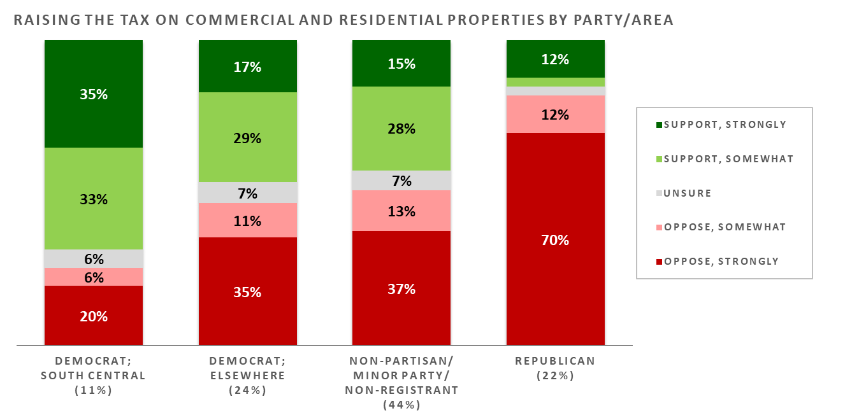
Raising Taxes is Unpopular
4-in-10 like the prospect of raising property taxes to fund low-income housing
But a majority – 54% – are opposed
And opponents are far more steadfast
Unsurprising given CA’s already-high tax burden and the current economic environment
Positions are largely driven by partisanship
Republicans are overwhelmingly opposed
Non-partisans, minor party members, and non-registrants also resistant
Democrats in south central communities are keen on the idea
Here housing costs pair with partisanship to create a pro-tax pocket
Democrats elsewhere are divided.
Page | 14

Slide 15
A Closer Look at Our Ethnic Communities
Latinos are more strongly supportive of raising taxes to build more low-income housing
There’s more support than opposition within the AAPI and African American communities.

Slide 16
Residential Development Near Mass Transit
Page | 16

Slide 17
Residents are Largely Supportive
A whopping 73% like this tax-free idea
Only 1-in-5 are opposed
We can expect pushback from residents near where the development would occur
See: Local organization fights back against City of San Diego housing plan with lawsuit
Thwarting the hyper-local NIMBY mentality isn’t easy.
Page | 17

Slide 18
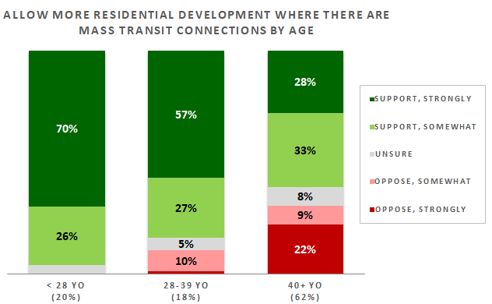
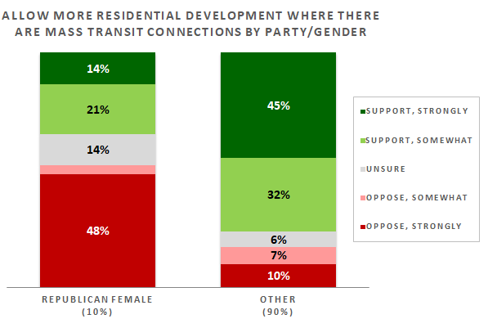
Nearly All Types of San Diegans Favor the Proposal
We therefore dub thee “smart growth”
Residents < 28 love this plan
Those aged 28-to-39 also on board
Older adults are supportive, but take a wait-and-see stance
Folks wanting more apartments and rental housing are also fans
GOP women are only decidedly opposed group
Pushback to infill proposals will be strongest among them
But they only account for 10% of population
Far more backing from highly-educated residents
South suburbs contain almost as many supporters as opponents
Significant development there has curbed residents’ appetite
Communities between I-8 and SR-52 are also less enthusiastic
Even a vast majority of the residents who don’t think housing affordability has reached the critical stage support this plan…
…As do most who see too much residential development as an extremely serious problem!
Page | 18

Slide 19
A Closer Look at Our Ethnic Communities
Latinos and Blacks love the idea of more residential development in transit-oriented neighborhoods
AAPI views are on par with those of the broader population.

Slide 20
Thank You!

Slide 21
Public Opinion · Public Policy · Organizations · Campaigns
1987 – Founded in San Diego
1988 – Phonecenters established in Riverside, CA and San Diego
1990 – Phonecenters established in Reno, NV and San Diego
1992 – Predictive dialing installed to double interviewing capacity; CERC calls San Diego Mayor’s race
1993 – "The Edge" newsletter launches
1998 – Qualitative focus groups introduced
2000 – CERC calls San Diego Mayor’s race
2003 – KPBS/Competitive Edge Research Poll and annual Super Bowl poll launched
2004 – CERC calls San Diego Mayor’s race (x2)
2005 – CERC calls San Diego Mayor’s race (x2)
2006 – SDIPR/CERC Opinion Barometer launched; Ballot measures paper presented at AAPOR Conference
2008 – CERC calls San Diego Mayor’s race; Convenes post-election summit @ USD
2009 – Interviewer effects paper presented at AAPOR Conference
2010 – Web-based interviewing and custom panels introduced
2012 – Dial-testing introduced; CERC calls San Diego Mayor’s race (x2)
2013 – CERC calls San Diego Mayor’s race; Business Forecast survey launched
2014 – CERC calls San Diego Mayor’s race
2016 – CERC calls San Diego Mayor’s race
2017 – Phonecenter established in El Paso, TX
2018 – CERC calls CA Governor’s race (x2)
2019 – Ballot measure wording paper presented at AAPOR Conference
2020 – Incumbent viability paper accepted for presentation at AAPOR Conference
2022 – San Diego County Issues Barometer launched
John Nienstedt, MA Political Science: President
Member, American Association for Public Opinion Research
Insights Association
SBA Entrepreneurial Success Award (2000)
Pollster of the year (x7)
Rachel Lawler, MA Political Science: Research Analyst
Member, American Association for Public Opinion Research
Ronald Zavala: Director of Operations
James Iwu: Research Assistant

